Slide 1

ATG Entertainment UK
Gender Pay Gap Reporting
GET NEW PHOTO
March 2025

Slide 2
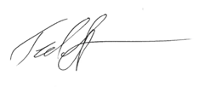
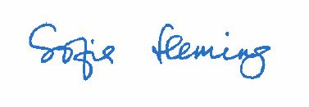
Gender Pay Gap Reporting
As part of the government’s aim to close the gender pay gap within a generation, recently introduced regulations require all companies with 250 or more employees in England, Scotland and Wales to publish information regarding their gender pay gap on their company website and on a dedicated government website.
This report includes the required disclosures, and we confirm the data reported herein is accurate.
Ted Stimpson Sofia Fleming
Group Chief Executive Officer Chief HR Officer

Slide 3
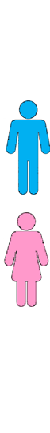
2024 Disclosures
Pay Gap Bonus Gap
Median Gender Bonus Pay Gap 40.0%
Mean Gender Bonus Pay Gap 32.6%
Proportion of Males receiving a Bonus Payment 24.3%
Proportion of Females receiving a Bonus Payment 19.7%
ATG Median Gender Pay Gap | 0.0%
ATG Mean Gender Pay Gap | 12.5%

